Slide 1
3. Conversion
Friday, 01 November 2024
Review:
Put these in the correct order for Teresa of Avila
Garden Analogy | Castle analogy
Union: Finding the connection to God is easier, whole focus is on God. Meditation: focus thoughts on the life of Jesus. Rapture: indescribably without control from the person praying. Prayer of Quiet: feel a sense of contentment and rest in God. | Spiritual marriage with God Gives knowledge of the importance of prayer Taken over by God. Learning discipline but makes mistakes Complete union with God Easily distracted The soul rests in prayer

Slide 2
3. Conversion
Friday, 01 November 2024
Review:
Correct answers
Garden Analogy | Castle analogy
Meditation: focus thoughts on the life of Jesus. Prayer of Quiet: feel a sense of contentment and rest in God. Union: Finding the connection to God is easier, whole focus is on God. Rapture: indescribably without control from the person praying. | Easily distracted Gives knowledge of the importance of prayer Learning discipline but makes mistakes The soul rests in prayer Taken over by God. Spiritual marriage with God Complete union with God

Slide 3
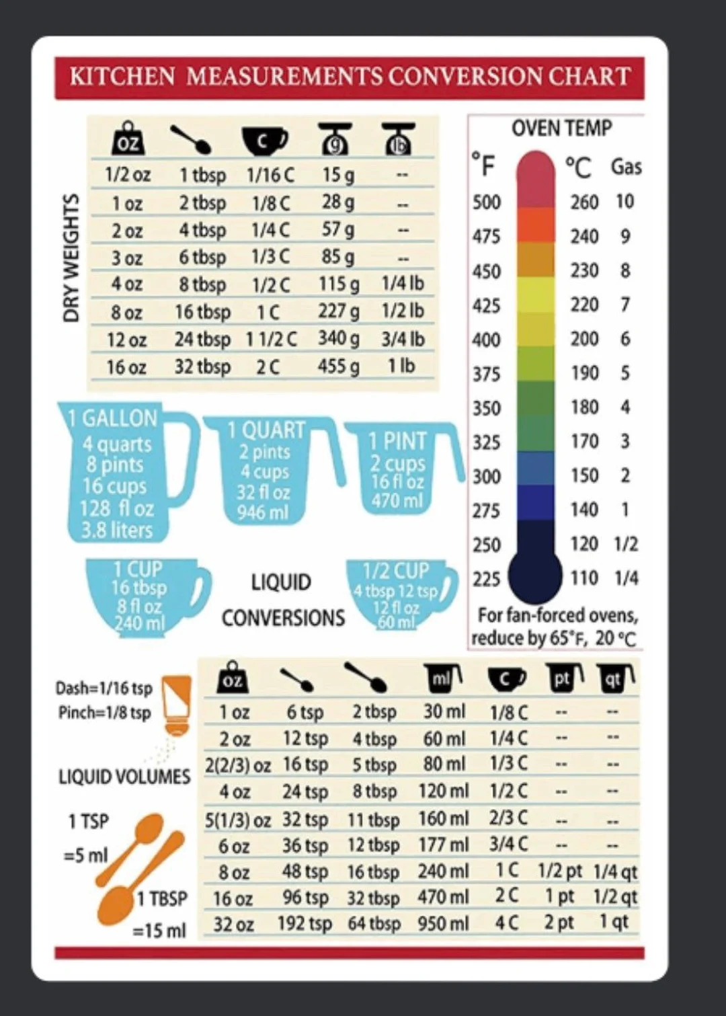
Conversion experiences
In a non-religious context, what do we mean by conversion?

Slide 4
Conversion experiences
In a non-religious context, what do we mean by conversion?
KEY TERM: Conversion means literally ‘turning around’ but refers, here, to a change in belief or orientation in religion.

Slide 5
Religious Conversions
Using the examples from the videos, cards, and textbook (pp176 – 180) make a summary of the following:
An example of an individual conversion
An example of a collective conversion
An example of an active conversion
An example of a passive conversion
Extras:
What things are shared between the examples we look at?
Do you notice anything similar or different between examples?
Who or what is missing from the examples in the textbook?

Slide 6
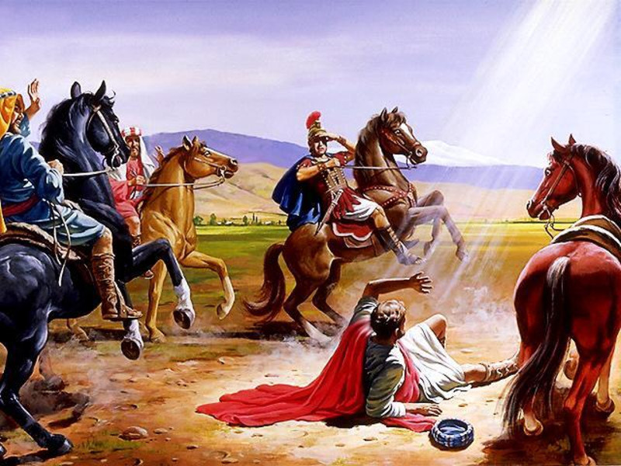
St Paul’s conversion
Saul’s Conversion
Ananaias
https://youtu.be/rLZ67inPx-4

Slide 7
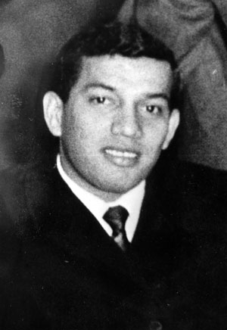
Sudden conversion
Nicky Cruz
https://youtu.be/Jhb3yTMMeN8

Slide 8
Mini Essay
Using what we have considered about evaluation, write a mini essay (outline plan of what points you will make and an evaluative conclusion).
“Is there a clear, unified, understanding of conversion experiences?”

Slide 9
Summary
After each lesson rule off a summary box. Write the prompts (if there are any).
Return to the summary box in your next study session (1 hour< x > 24 hours) and complete it without your notes
This will help you recall what you have learned which will make it stick better in your memory.
What is meant by a conversion experience?
What are some of the challenges of conversion experiences

