Slide 1
2024﻿
SATURDAY 12TH OCTOBER
SATURDAY 2ND NOVEMBER
SATURDAY 23RD NOVEMBER

Slide 2
Biology Olympiad
Business
Computing
Dance, Drama & Musical Theatre
Earth Games Olympiad
Education & Teaching
Engineering
English & Creative Writing
History, Geosciences & Social Sciences
Law, Criminology & Policing
Media & Film
Medicine
Psychology
Sport & Physical Activity

Slide 3
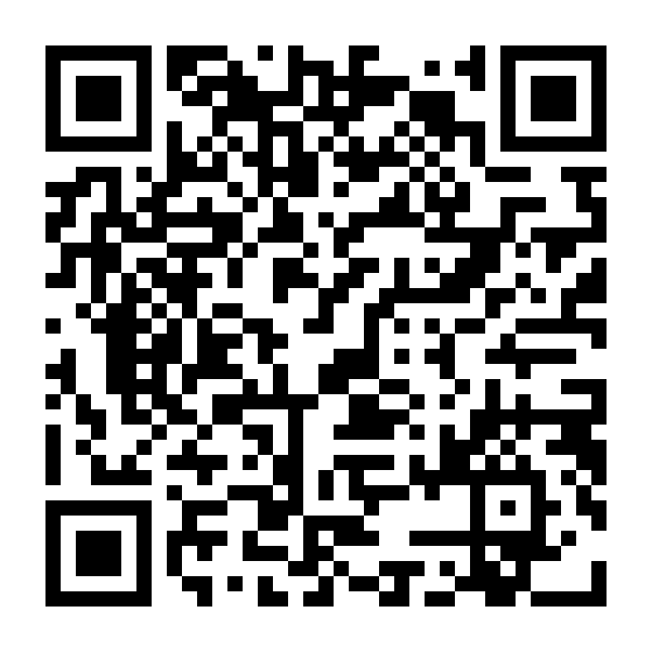
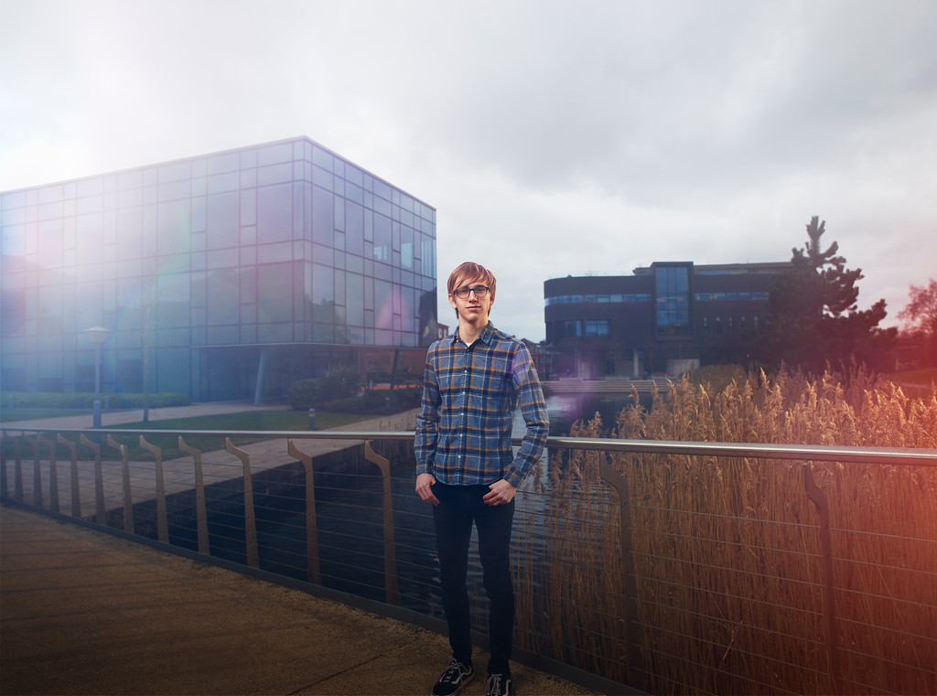
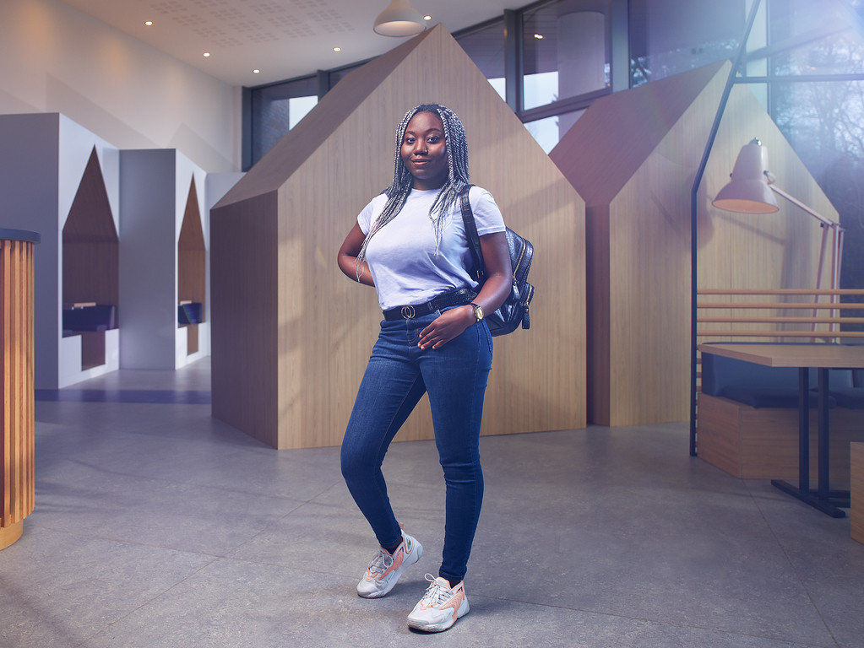
TAP Platform
TAP platform
Scan the QR code and chat to current students about:
Student life/experience
Their course and department
Accommodation/commuting

