Slide 1
Share the link - https://bit.ly/EHUHUB1-2023
Recording !
Research review series: computing
Published 16 May 2022
A short review
Nicola Looker (lookern@edgehill.ac.uk)
Lecturer in Secondary Education (Computing)
Notes:
Welcome to this short overview
This review explores the literature relating to the field of computing education. Its purpose is to identify factors that can contribute to high-quality school computing curriculums, assessment, pedagogy and systems. We will use this understanding of subject quality to examine how computing is taught in England’s schools.

Slide 2
“This [computing research] review explores the literature relating to the field of computing education. Its purpose is to identify factors that can contribute to high-quality school computing curriculums, assessment, pedagogy and systems. We will use this understanding of subject quality to examine how computing is taught in England’s schools.” (Ofsted, 2022)
Notes:
Ofsted (2022) Research review series: Computing, GOV.UK. GOV.UK. Available at: https://www.gov.uk/government/publications/research-review-series-computing (Accessed: January 15, 2023).

Slide 3
Selecting research
“Educational research is contestable and contested, and so are documents such as these research reviews. Therefore, we are sharing our thinking with subject communities so that we can get input from the broader subject community.” (Ofsted, 2021)
As well as academic papers, the research review will also include information from:
Education Endowment Foundation
Department for Education
large-scale international studies, such as the Programme for International Student Assessment (PISA)
our own research and guidance
secondary evidence, such as teacher-authored blogs
Filters used to select research:
An understanding that curriculum is different from pedagogy
How people learn and, in particular, cognitive science
Relevance to inspection
Subject specificity
What will achieve the aims of subject education

Slide 4
In this session you will explore findings of the report and share practice from your schools to answer together the following questions:-
What are the benefits and drawbacks of the following pedagogies and what examples can you share from your own practice:-
Story Telling
Worked Examples
Unplugged activities
Use of textbooks (and other textual resources)
When teaching programming (a difficult problem!), how can the following ideas help:-
Programming and cognitive load
The notional machine
Novices and experts
Program comprehension and the block model
How have you tried to address the persistent gender divide in computing? What impact has this had?
The idea behind these hub meetings is for teachers to share their experiences and engage with the emerging computer education evidence base. Hopefully these conversations will spark ongoing collaborations between computing teachers, initial teacher educators and trainees - and support all of us engaged in the noble endeavour of teaching the nation about computing!

Slide 5
Computing Pedagogies
Story Telling
Worked Examples
Unplugged activities
Use of textbooks (and other textual resources)

Slide 6
Story Telling
Storytelling is one of the oldest methods of sharing and communicating knowledge. Psychologists refer to stories as ‘psychologically privileged’.^{[footnote 138]} This means that they are organised differently in memory than other types of content. The story of the ‘Cat in the hat!’ by Dr Seuss, for example, is a memorable way of helping pupils understand the computing concept of recursion, with increasingly smaller cats appearing to clean a bath tub.^{[footnote 139]}
The structure of stories is important. Willingham highlights that curriculum content can be organised within the lesson using the structure of stories, for example, using causality, conflict, complications and character as a framework for sequencing lessons.^{[footnote 140]} Curzon and others highlight that in computing ‘the links from the story to the technical concepts, again, have to be made clear – travelling the semantic wave’.^{[footnote 141]} This means that, if stories or analogies are used, they should be linked back to the specific computing concept they represent. The teacher should make clear the differences and similarities between the representation and the concept.
OFSTED, 2022. Research review series: computing. GOV.UK [online]. Available from: https://www.gov.uk/government/publications/research-review-series-computing/research-review-series-computing

Slide 7
Technology – the pace of change (Approach 1)
These things double approximately every 2 years:-
number of transistors on a chip
amount of computing power for the same cost
the amount of storage capacity for the same cost

Slide 8
Technology – the pace of change (Approach 2)
Today's car differs from those of the immediate post-war years on a number of counts. It is cheaper, allowing for the ravages of inflation, and it is more economical and efficient... But suppose for a moment that the automobile industry had developed at the same rate as computers and over the same period :
How would cars be different?

Slide 9
Technology – the pace of change
If you have not already heard the analogy the answer is shattering. Today you would be able to buy a Rolls-Royce for £1.35, it would do three million miles to the gallon, and it would deliver enough power to drive the Queen Elizabeth II. And if you were interested in miniaturisation, you could place half a dozen of them on a pinhead. - Christopher Evans, "The Mighty Micro", (1979)

Slide 10
What effective “stories” do you tell (and why do they work?)
Copy and paste this post-it - add your storytelling example
Jamie - Real world input/outputs i.e. on your way to school what do you interact with. Car unlocks via the wireless contact/key. Lights switch on due to the dusk sensor. Parents drop off at the end of the road, you press the button on the pedestrian crossing etc.
CS4FN - https://www.cs4fn.org/computationalthinking/searchingtospeak/
Linking to the Queen’s Knickers the children had to design a new pair for her. These were then placed on a grid for Beebots.
Primary is all cross-curricular so automatically links to other areas i.e. WW2 code cracking making Morse Code machines using Crumbles.
Viking Raid on Lindisfarne - writing their own story and then animating in Scratch,
Walking around school -discussing networks - make it real.
Jo
When teaching how CPUs work I try to link to how McDonalds works. E.g. they have certain orders in the cache like cheeseburgers that are commonly ordered. Others require more resources. More chefs/checkout staff = more cores etc… GK

Slide 11
Worked Examples inc. Subgoals
[...] instructional guidance is important for pupils who are novices, and these pupils require ‘scaffolding’ to help them develop knowledge.One approach to ‘scaffolding’ is using worked examples.
Tuovinen and Sweller, and Skudder and Luxton-Reilly, found that students substantially benefited from worked examples [but they] made less difference for those with more prior knowledge. This difference [...] between novices and experts has implications for curriculum sequencing. [indicating] faded worked examples, where steps are removed from worked examples over time, [...] as pupils develop expertise.
[DECOMPOSITION] Subgoals are useful steps in solving complex problems and act as functional components of the problem’s solution. Labels are added to each subgoal to explain its purpose. This scaffold helps novices to tackle the component parts of a much larger problem. Subgoals can also help pupils see past the surface-level features in problems and transfer this knowledge to new problems. This is because the subgoals focus on abstract knowledge and not the surface features of the problem.
Margulieux and others discovered that novice students in undergraduate classes who used subgoals in a block-based programming environment were able to complete more steps, more quickly, than novice students who were not given subgoals. This group were also better able to recall content subsequently. This work highlighted the benefits of subgoals in reducing cognitive load. Robins and others note a further study that found that pupils performed better in text-based programming languages when using subgoals.
OFSTED, 2022. Research review series: computing. GOV.UK [online]. Available from: https://www.gov.uk/government/publications/research-review-series-computing/research-review-series-computing

Slide 12
https://www.stepneyallsaints.school/content/uploads/2020/07/BTEC-Computing-Task-3-Problem-solving.pdf

Slide 13
How have you sequenced your curriculum to make use of (faded) worked examples? What are the advantages of subgoal-labelling?
Copy and paste this post-it - add your response
We use an I do, We do and then you do approach where I demo a skill/technique, we work together on a similar example and then they work on pieces together with less/no scaffolding. So almost faded worked examples every lesson when coding.
Have also started to let Y11 use the AI feature in REPL.it to help them create more ambitious code.
Jamie - PRIMM for the starter tasks and retrieval, followed by tasks centred around predicting before practicing/improving
Jamie - Solution to a flow chart, and then have to break it down into pseudocode to reverse engineer it slightly
Use of PRIMM when programming - give sample pieces of code to explore and annotate. Run and then Investigate the code - did it do what they predicted?
Parson’s problems - give them the blocks either unplugged or in a Scratch file to them use and create their code.
Before they begin coding all children write pseudocode first or a written description of what they wish to achieve before they begin - examples would be given for another problem which they can then relate to their new problem.
Use of Barefoot unplugged lessons to develop code ideas. Pair/programming - debug the code.
Jo
Jamie - Problem solving homeworks, where they must identify errors/adapt code around a change to the solution

Slide 14
Unplugged activities
Research from 2017 found that unplugged activities were one of the most common pedagogical approaches taken by computing teachers in the UK. Unplugged activities can be useful in introducing computing concepts to pupils at the early stages of their computing education. However, when choosing unplugged activities, teachers should pay careful attention to how the activity will contribute to achieving curriculum goals.
An analysis from 2012 identified that not all unplugged activities are strongly linked to computing subject content. Furthermore, they might introduce misconceptions. For example, unplugged activities to teach pupils about algorithms can be ambiguous and in opposition to the unambiguous nature of algorithms as precisely defined procedures.
Teachers should also consider pupils’ prior knowledge when selecting unplugged activities, as these activities appear to be more useful when introducing new knowledge. For instance, when pupils already possess knowledge related to the activity, they can become uninterested in unplugged activities. Research also indicates that the use of unplugged activities may reduce pupils’ desire to study computing when these are not well linked to computing concepts.
OFSTED, 2022. Research review series: computing. GOV.UK [online]. Available from: https://www.gov.uk/government/publications/research-review-series-computing/research-review-series-computing

Slide 15
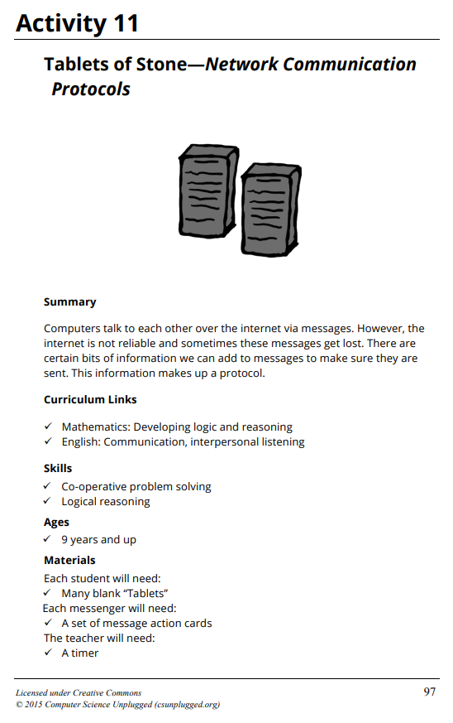
Unplugged
Notes:
Issues: Time! Everyone? busy - but who has an overview? Reveals lots about protocols - if you have the right lens (prior knowledge) - do pupils have this?

Slide 16
What Unplugged activities have worked especially effectively? Which have been problematic?
Jamie - I'm not a massive fan of unplugged but I do a cipher one which is explaining how a message is encrypted so I allow the pupils to work in teams and send messages to each other but one has to have the cipher key etc and they can only be a certain role (plain text, cipher text, key etc). It is nice but they do get fed up fast. (This would only ever be a 15 min or so)
Copy and paste this post-it - add your response
I only use unplugged when the network goes down. I find the time spent setting up and then trying to explain differences from real world systems is wasted time.
Things like instructions for a robot walking around a room when introducing sequences works.
Also using a grid and 1s and 0s to “transmit” an image to be recreated at the other end but often goes wrong so have kind of abandoned the idea.
Algorithm on a piece of paper for OXO is quite good.
CS4FN 21 card magic trick - great for algorithms
Use unplugged all the time but not always for the entire lesson. Sometimes they are a snapshot or quick starter - i.e. Barefoot Bytes. Or can be a hand jive to introduce new vocab i.e. an algorithm
Just Dance used to introduce algorithms - they then would code their own routine using Scratch.
Beebot Dance - children would plan out their dance to music then use the arrow cards to program their Beebot . They physically are a Beebot - wear a Beebot Hat - work in pairs.
Got many more…
Jo

Slide 17
Use of textbooks (and other resources)
A policy paper from 2014 identified the importance of textbooks in high-performing education systems. They “may provide considerable support to both teachers and pupils’, especially when there is a gap in teachers’ subject knowledge. This is particularly relevant to computing, where we have already noted the issue of teachers’ subject knowledge.
[BCS] - stakeholders felt that [...] textbooks can provide a progression model through the hierarchical structure of the subject.
OFSTED, 2022. Research review series: computing. GOV.UK [online]. Available from: https://www.gov.uk/government/publications/research-review-series-computing/research-review-series-computing

Slide 18
Share your favourite textbook resource recommendations. Do any particular textbooks help you sequence?
Jamie - Quite like the GCSE revision books for EDEXCEL as they have the guide then workbook so it shows the link between the content and practical examples/questions.
Paul Long digital resources and Craig and Dave videos is amazing for GCSE. I use both via Teams Class notebook and it has accelerated the learning and revision.
GCP books are pretty good for revision too.
Copy and paste this post-it - add your response
Jamie - have a few old school KS3 textbooks that are used at times for more common concepts i.e algorithms, CPU.
We would not use textbooks to be honest - for teacher subject knowledge I would refer staff to the Teach Computing or Barefoot resources as support videos etc.
Twinkl also have some useful resources for staff.
Lots of resources have how top videos which help staff.
Jo
Jamie - Online revision systems such as know it all ninja, which include a range of learning styles.

Slide 19
Section Two - Programming
Programming and cognitive load
The notional machine
Novices and experts
Program comprehension and the block model

Slide 20
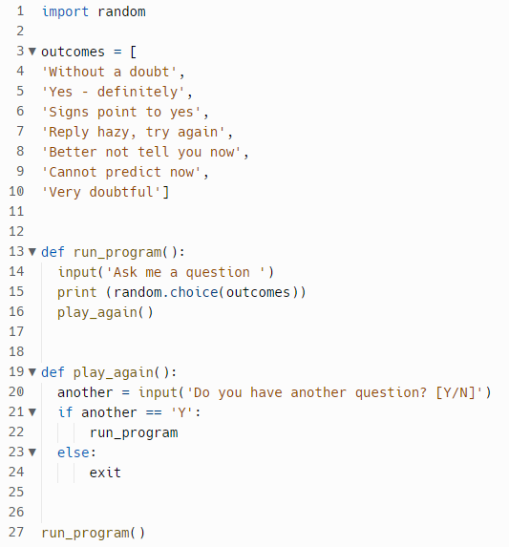
Requires an input string
Displays a random response from the outcomes list
Final user input will be terminal
1 Check the libraries and what they do.
2 Look at the block structure - some definitions then 2 procedures - what calls what?
3 Look at the data structure - list
CS
What does this code do?
Think about the process you follow in trying to comprehend the code.
What do you need to know in order to understand the code?
Answers on a post it…
lists/arrays
Importing libraries
Syntax for creating lists.
Indexing.
subroutines/procedures.
Selection. sequences.
What the Import random is? How is it defined. Indenting and syntax - for the code to run,
JH (Primary!)

Slide 21
Computer programming is intrinsically complex…
Programming involves:
understanding a problem and what can be achieved computationally
understanding the syntax and semantics of the programming language
knowing how to put syntax together to produce particular results
knowing how the computer executes programs
knowing how to implement, test and debug solutions
Further complicated by the fact that these stages are often all going on at the same time. (Du Boulay, 1986)
This complexity has the potential to lead to high cognitive load (high element interactivity) which literature suggests can be detrimental to learning.

Slide 22
Idealised abstraction of computer hardware and other aspects of the runtime environment
Their purpose is to understand what happens during program execution
They are associated with programming languages
Enables semantics of program code to be described
Gives a perspective of execution
Correctly refers to what programs do when executed
Notional Machines:
What are they?

Slide 23
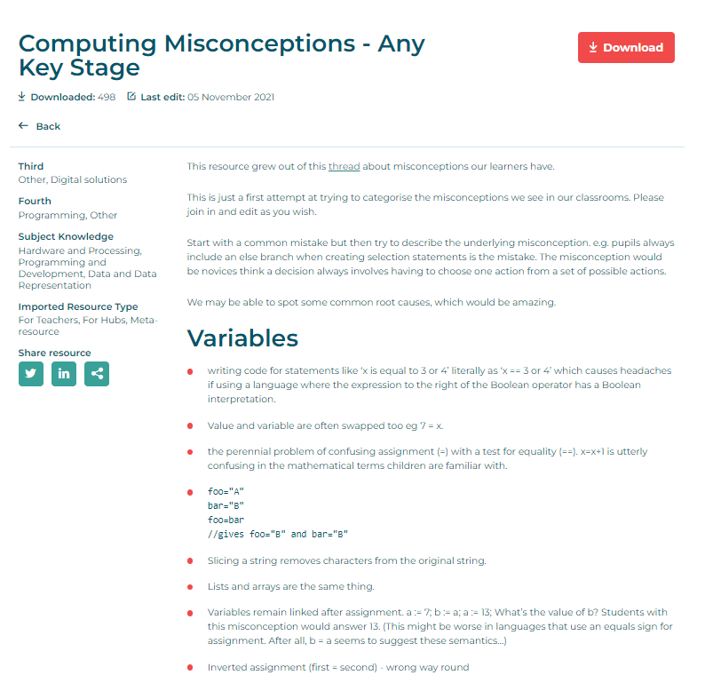
Computing at School: Computing Misconceptions
Swidan, Alaaeddin & Hermans, Felienne & Smit, Marileen. (2018). Programming Misconceptions for School Students. 151-159. 10.1145/3230977.3230995.

Slide 24
Programming:
What works? What do you struggle with?
How do you address misconceptions?
Trial and error
PRIMM
Modeling/scaffolding
Use of online IDE’s i.e. Trinket & Replit
Live coding - no (or maybe I don't quite understand) I demo on the board with code i.e. pupils watch the example as I code then run it?
^ (CS) I guess the difference is do you model how to solve a problem and what you are thinking when you do? I understand yes I do this but not always in detail due to confidence!
Star a comment if you second it
Teaching different paradigms is often overlooked - just assume they can move from event driven scratch to iterative Python
Love live coding - don’t mind looking like a fool - they should see the head scratching moments - and can feel cleverer than a teacher
Y7 - LOGO focused on precision, sequencing + interaction then scratch to introduce variables, selection and procedures.
Y8 move them onto Python and show how it is similar to scratch and LOGO.
Then take them further with Python in Y9.
Yes we do live coding.
We struggle with time though. 1 hour per week and so much to cover, how much time should coding get in KS3?
At KS4 i encourage them to interact with the AI to ask questions and solve problems but only when they have mastered most of the basics.
They love it when i make “deliberate” mistakes and they have to point them out.
Use of PRIMM works brilliantly alongside unplugged. I have found these to be very successful.
Real-life examples/ CS Unplugged have some great stuff too.
.Time to tinker with the software and then discuss - give them a challenge fo something to find out. Then they can share with the class.
Micro-bit classroom is perfect for this as children can show their code and demo how it works. This can be edited and debugged as they code.
Good to make mistakes yourself and ask them where it has gone wrong - they lobe telling you!
Jo

Slide 25
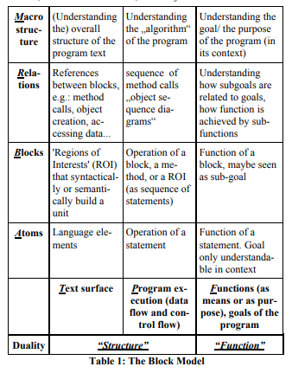
Program comprehension
and the Block Model
(Schulte, 2008)
A helpful tool for understanding and categorising aspects of program comprehension and allows the teacher to plan for specific learning activities and trajectories.

Slide 26
This framework captures what level the learner is focused on:
Atoms - elements and individual lines that make up the program
age = 35
Blocks - clusters of adjacent lines that are strongly connected - loops, functions, selection statements
if age >= 70:
print("You are aged to perfection!")
elif age == 50:
print("Wow, you are half a century old!")
else:
print("You are a spring chicken!")
Relations - related lines that are not next to one another but are still strongly linked. Eg. code calling procedures and functions
Macro - refers to the program as a whole
Four levels of complexity (y axis)

Slide 27
The program exists as a static piece of text. This is called the text surface (T) and is where learners need to consider the grammar and syntax of their program.
When the program is executed, it becomes a dynamic object that may behave differently depending on its inputs. This dimension is known as the program execution (P).
The function (F) is the purpose of the code or programs.
Example:
T: age = 35
P: Trace the value - the value 35 with be stored in the variable age
F: Explain the purpose - Store 35 in age
A program has three dimension (x axis)

Slide 28
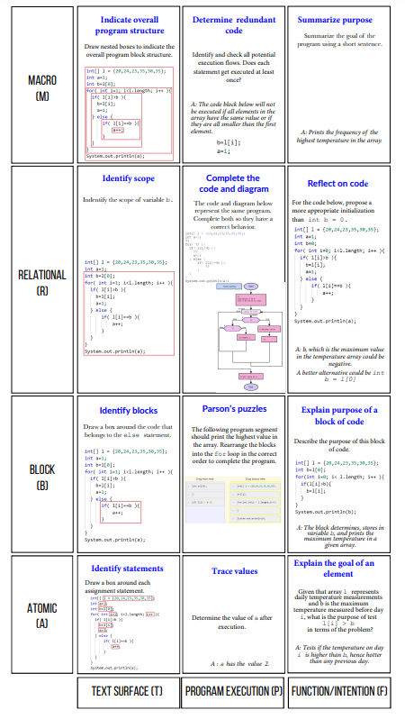
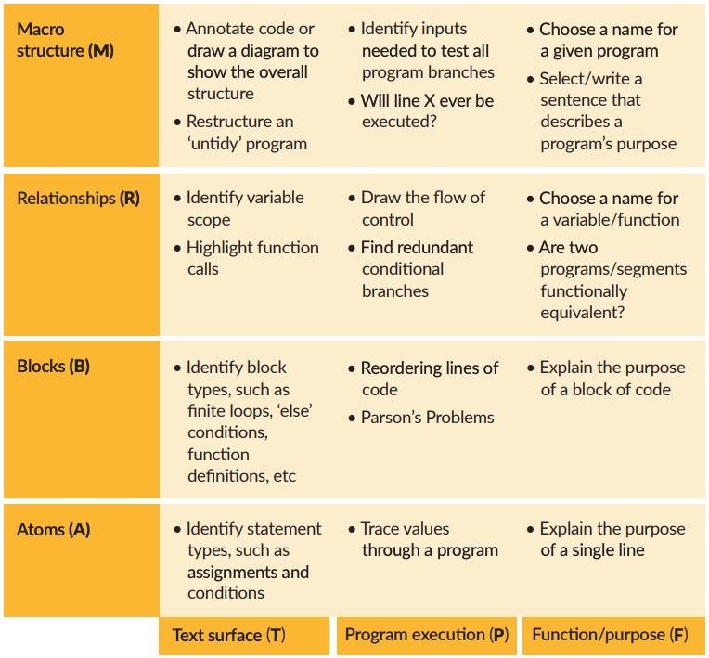
Source: Teach Computing - Pedagogy quick reads
Source: Fostering Program Comprehension in Novice Programmers - Learning Activities and Learning Trajectories (Izu et al, 2019)
Notes:
Four levels of complexity (y axis)

Slide 29
How experts differ from novices (Tormey et al., 2021)
Experts see important patterns
Experts recall knowledge from the domain quickly and they complete representative tasks fluently
Experts have characteristic ways of thinking about problems in their domain
Experts remember the right information in a given context
Experts monitor themselves better than novices
Experts feel differently than novices
Expertise is social
PA Kirschner, J Sweller and RE Clark, ‘Why minimal guidance during instruction does not work: an analysis of the failure of constructivist, discovery, problem-based, experiential, and inquiry-based teaching’, in ‘Educational Psychologist’, Volume 41, Issue 2, 2006, pages 75 to 86.↩

Slide 30
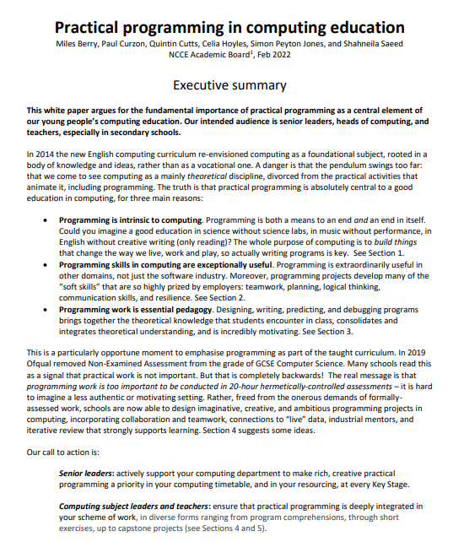
The importance of practical programming
Programming is intrinsic to computing
Programming skills in computing are exceptionally useful
Programming work is essential pedagogy
White paper: Practical programming in computing education

Slide 31
Section three - Gender

Slide 32
The Roehampton annual computing education report from 2018
The key findings are that:
The number of hours of computing/ICT taught in secondary school dropped by 35.8% from 2012 to 2017. Across the country, KS4 saw 31,000 fewer hours taught per week, a 47% decrease.
In Key Stage 3 (KS3), the time given for computing dropped from an hour in 2012 to just over 45 minutes in 2017, despite the marked increase in the demands of the national curriculum at this level.
The overall number of qualifications taken by students at Year 11 decreased by 144,000, or 45%, between 2017 and 2018.
The percentage of students sitting GCSE computer science increased marginally from 12.1% in 2017 to 12.4% of all GCSE students in 2018.
Whilst overall numbers of GCSE computer science providers were up, 8.2% of schools that offered the subject in 2017 were not offering it in 2018. In this group, one in five (19%) girls’ comprehensive schools who offered GCSE computer science in 2017 dropped it in 2018.
With GCSE computer science student numbers levelling out and the removal of GCSE ICT in 2018, a further decline in the total numbers of hours of computing taught and qualifications taken seems highly likely for 2019.
Peter E. J. Kemp, Billy Wong, and Miles G. Berry. 2019. Female Performance and Participation in Computer Science: A National Picture. ACM Trans. Comput. Educ. 20, 1, Article 4 (March 2020), 28 pages. https://doi.org/10.1145/3366016

Slide 33
Gender
2021 Examinations:
21% at GCSE
15% at A Level
https://teachcomputing.org/gender-balance

Slide 34
What strategies have you tried to address the gender divide?
Star a comment if you second it

Slide 35
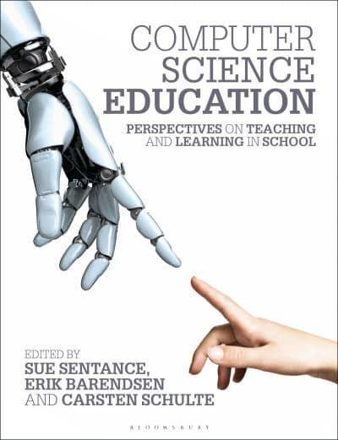
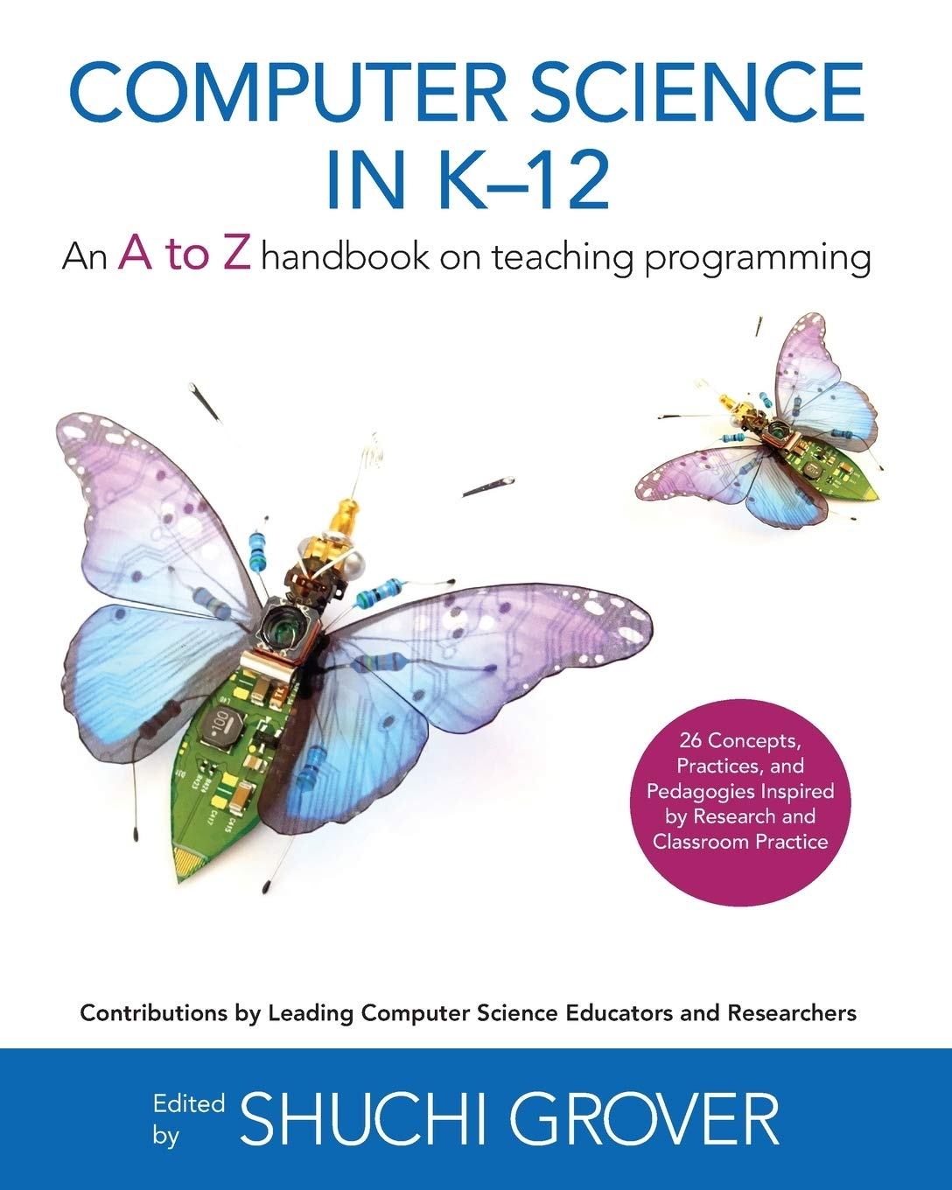
Recommended books. And if you are interested in doing MA…

Slide 36
References
Education Endowment Foundation (2021) Cognitive Science approaches in the classroom: a review of the evidence, London: Education Endowment Foundation.
https://www.gov.uk/government/publications/principles-behind-ofsteds-research-reviews-and-subject-reports/principles-behind-ofsteds-research-reviews-and-subject-reports
https://teachcomputing.org/gender-balance
https://blog.teachcomputing.org/tag/quickread/
Juha Sorva. 2013. Notional machines and introductory programming education. ACM Trans. Comput. Educ. 13, 2, Article 8 (June 2013), 31 pages. https://doi.org/10.1145/2483710.2483713
Quintin Cutts, Matthew Barr, Mireilla Bikanga Ada, Peter Donaldson, Steve Draper, Jack Parkinson, Jeremy Singer, and Lovisa Sundin. 2019. Experience Report: Thinkathon -- Countering an "I Got It Working" Mentality with Pencil-and-Paper Exercises. In Proceedings of the 2019 ACM Conference on Innovation and Technology in Computer Science Education (ITiCSE '19). Association for Computing Machinery, New York, NY, USA, 203–209. https://doi.org/10.1145/3304221.3319785
Izu, Cruz & Schulte, Carsten & Aggarwal, Ashish & Cutts, Quintin & Duran, Rodrigo & Gutica, Mirela & Heinemann, Birte & Kraemer, Eileen & Lonati, Violetta & Mirolo, Claudio & Weeda, Renske. (2019). Fostering Program Comprehension in Novice Programmers - Learning Activities and Learning Trajectories. 27-52. 10.1145/3344429.3372501.
Richard Connor, Quintin Cutts, and Judy Robertson. 2017. Keeping the machinery in computing education. Commun. ACM 60, 11 (November 2017), 26–28. https://doi.org/10.1145/3144174
Sentance, S., Barendsen, E., & Schulte, C. (Eds.). (2018). Computer Science Education: Perspectives on Teaching and Learning in School. London: Bloomsbury Academic. Retrieved January 23, 2023, from http://dx.doi.org/10.5040/9781350057142
Grover, Shuchi. (2020). Computer Science in K-12: An A-Z Handbook on Teaching Programing.
Fincher, S., & Robins, A. (Eds.). (2019). The Cambridge Handbook of Computing Education Research (Cambridge Handbooks in Psychology). Cambridge: Cambridge University Press. doi:10.1017/9781108654555

